Slide 1
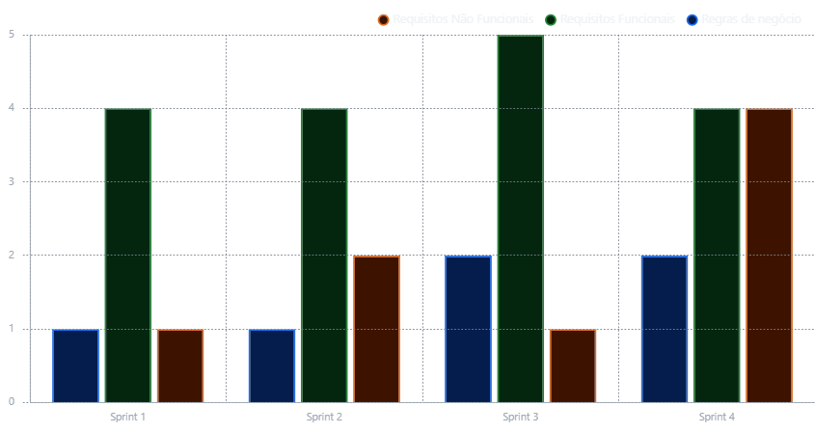
Sprint Backlog.
Count of items.

Slide 2
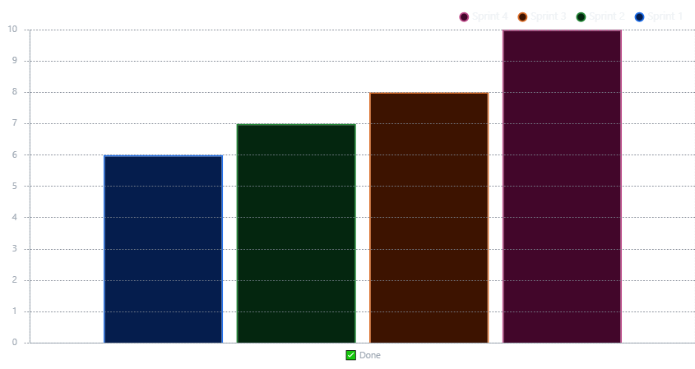
API Overview
Count of items.

Slide 3
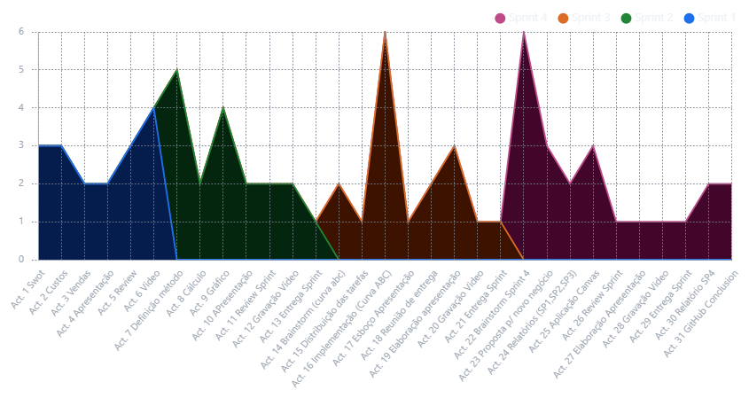
Entrega (Estimado)
Count of days.

Slide 4
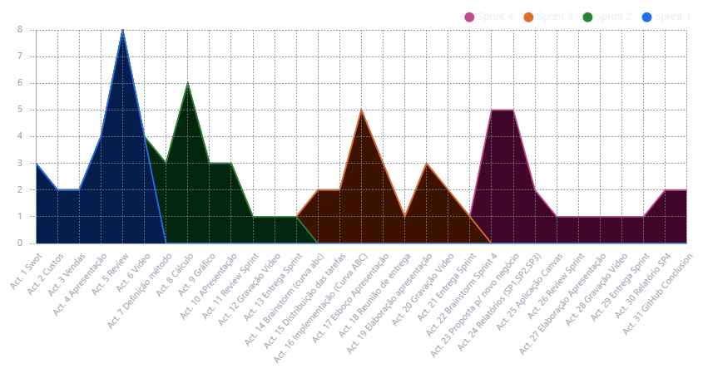
Entrega (Realizado)
Count of days.

